Slide 1
Design and Analysis of Algorithms
Problem Statements
Name: Achanta Pavan Santhosh Manideep
Roll no: 181210004
B.Tech – CSE -2nd year
National Institute of Technology

Slide 2
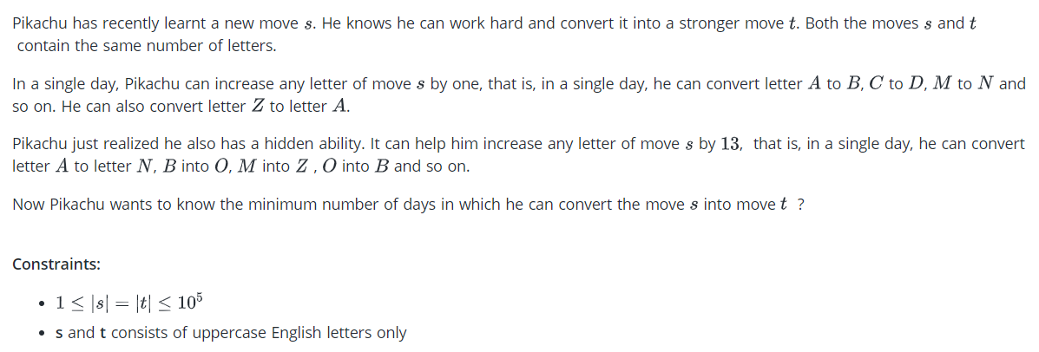
Greedy Algorithm

Slide 3
Greedy Algorithm - Implementation
Since each index is independent, we can try converting letters one-by-one.
For each index, we can calculate the days required without using the hidden ability as k using brute force. Now, if k>=13, we can introduce hidden ability to reduce the time taken by 12 days by changing 13 normal days with 1 hidden ability day.
We use greedy algorithm because:
Here each and every day, Pikachu decides whether to go one step or 13 steps depending on the starting and destination letters.
Each and every decision that Pikachu made should lead to it to the destination in minimum number of days.
All these individual decisions that were made by Pikachu give the minimum time required.

Slide 4
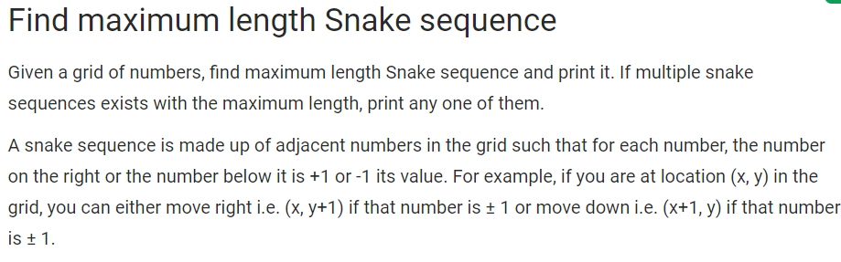
Dynamic Programming

Slide 5
Dynamic Programming - Implementation
The idea is to use Dynamic Programming.
For each cell of the matrix, we keep maximum length of a snake which ends in current cell.
The maximum length snake sequence will have maximum value.
The maximum value cell will correspond to tail of the snake. In order to print the snake, we need to backtrack from tail all the way back to snake’s head.
Let T[i][i] represent maximum length of a snake which ends at cell (i, j), then for given matrix M, the DP relation is defined as –
T[0][0] = 0 T[i][j] = max(T[i][j], T[i][j – 1] + 1) if M[i][j] = M[i][j – 1] ± 1 T[i][j] = max(T[i][j], T[i – 1][j] + 1) if M[i][j] = M[i – 1][j] ± 1

Slide 6
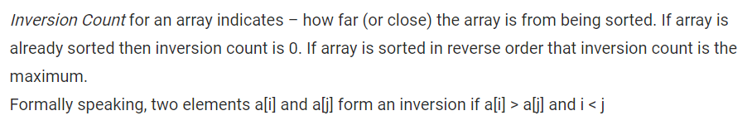
Divide and Conquer

Slide 7
Divide and Conquer - Implementation
The idea is similar to merge sort, divide the array into two equal or almost equal halves in each step until the base case is reached.
Create a function merge that counts the number of inversions when two halves of the array are merged, create two indices i and j, i is the index for first half and j is an index of the second half. if a[i] is greater than a[j], then there are (mid – i) inversions. because left and right subarrays are sorted, so all the remaining elements in left-subarray (a[i+1], a[i+2] … a[mid]) will be greater than a[j].
Create a recursive function to divide the array into halves and find the answer by summing the number of inversions is the first half, number of inversion in the second half and the number of inversions by merging the two.
The base case of recursion is when there is only one element in the given half.
Print the answer

Slide 8
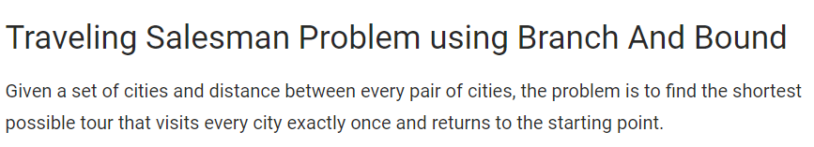
Branch and Bound

Slide 9
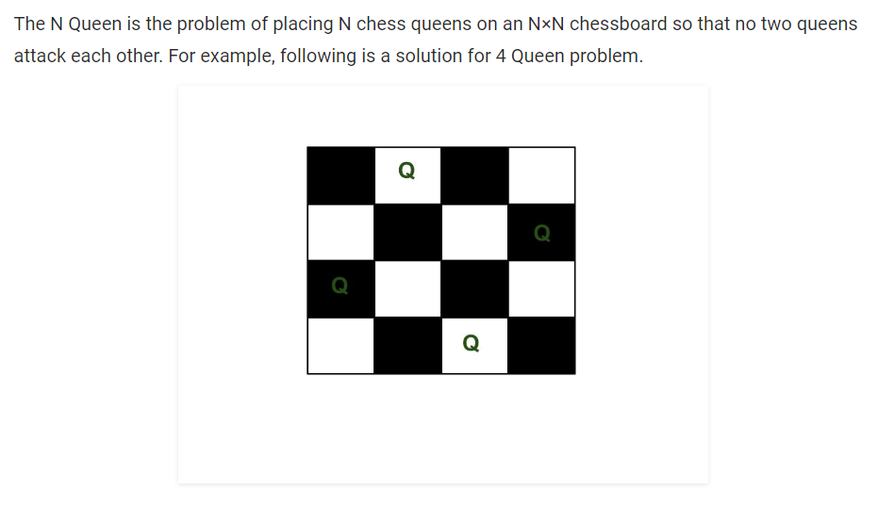
Back Tracking

Slide 10
Back Tracking – Implementation
The idea is to place queens one by one in different columns, starting from the leftmost column.
When we place a queen in a column, we check for clashes with already placed queens.
In the current column, if we find a row for which there is no clash, we mark this row and column as part of the solution.
If we do not find such a row due to clashes then we backtrack and return false.
Start in the leftmost column
If all queens are placed return true
Try all rows in the current column.
Do following for every tried row.
a) If the queen can be placed safely in this row then mark this [row, column] as part of the solution and recursively check if placing queen here leads to a solution.
b) If placing the queen in [row, column] leads to a solution then return true.
c) If placing queen doesn't lead to a solution then unmark this [row, column] (Backtrack) and go to step (a) to try other rows.
4) If all rows have been tried and nothing worked, return false to trigger backtracking.

